Slide 1

SMGT 800 – Case Analysis 1 (Group)
Logan Schraeder – X356T577
Alvee Islam – Z88Z549
Umer Tariq – X785Y683
October 2024
2025 Season Strategy Session
Inputs
Findings
Strategic Conclusions
“2024” Wichita Force Survey
N = 228
- Fan base is diverse across gender, age, and income
Arena Football Association Open Source Data
Increase minority-oriented marketing
Increase marketing along major arteries
Promote recurring high fan satisfaction
Provide discounted rates for group attendance
Invest in team and staff talent to grow wins
- Most fans reside in the Wichita metro and along I-70/I-35
- High correlation between word-of-mouth, event satisfaction, and future attendance
Analysis
- Minorities are under-represented in the fanbase
Cleaning and manipulation in Excel, Jamovi, and Tableau
- Fans like it when the Force wins!
Statistical, quantitative, and qualitative findings
*see backup slides for technical data

Slide 2
Backup Slides - Strategies
1. Increase minority-oriented marketing
2. Increase marketing along major arteries
3. Promote recurring high fan satisfaction
4. Provide discounted rates for groups and students
5. Invest in team and staff talent to grow wins
ENDS
- Introduce multi-cultural events that incorporate ethnic foods, performances, etc.
- Increase online, radio, and billboard marketing in major metros along I-35 & I-70
- Incorporate a points-based loyalty system to reward repeatedly-attending fans
- Use group attendance rates (discounts) to draw larger groups of new and return fans
- There is a positive connection between “star power” and fan attendance, sales (pro studies)
WAYS & MEANS
- Use student discounts to leverage WSU’s high multicultural body
- Look at strategic partnerships with pro teams and organizations to grow into already-established fan bases
- Introduce student discounts to grow attendance from the WSU student and faculty body
- Along with other factors, there is a positive correlation between money spent on good talent, coaching, and wins/losses (pro studies)

Slide 3
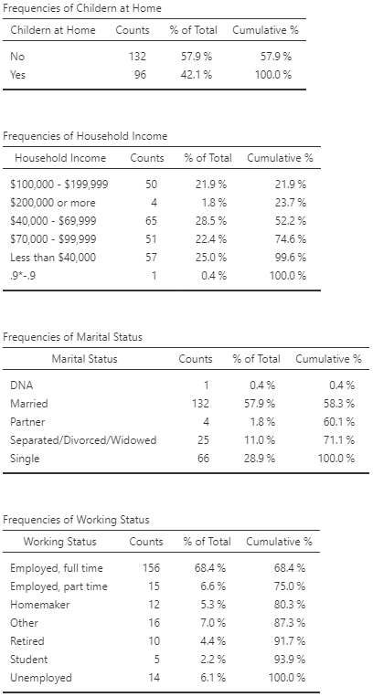
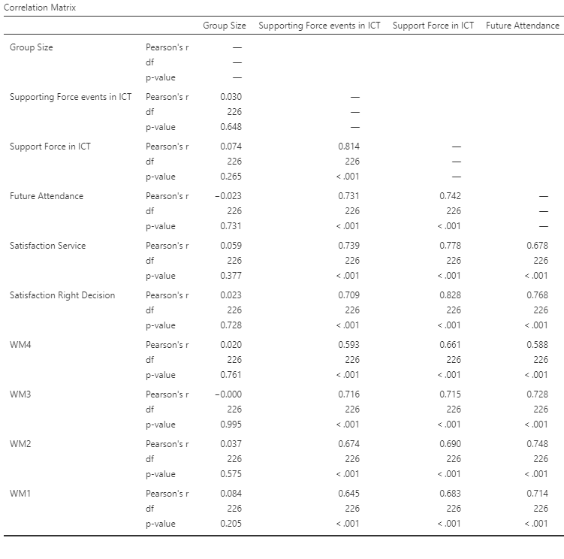
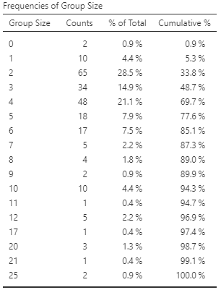
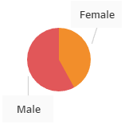
Backup Slides - Statistics
Bottom Line: Diverse fan base in most respects; high correlation between positive word of mouth and future attendance!

Slide 4
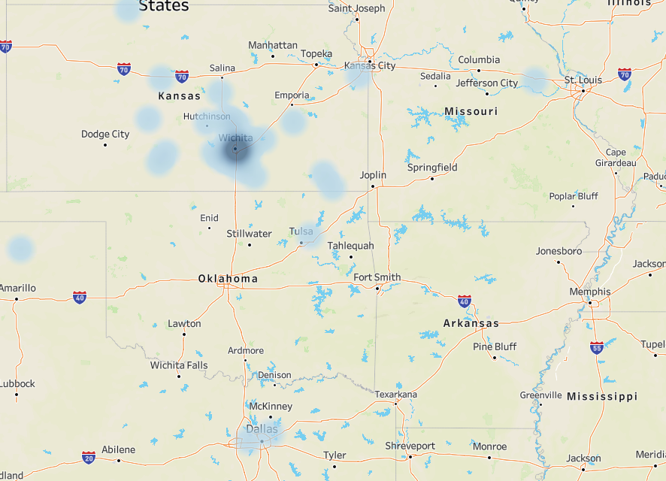
Backup Slides - Geography
I-70
Force fan density
2 major metros within 3 hours of ICT
I-35
4 major metros within 6.5 hours of ICT
All cities with major pro teams!

Slide 5
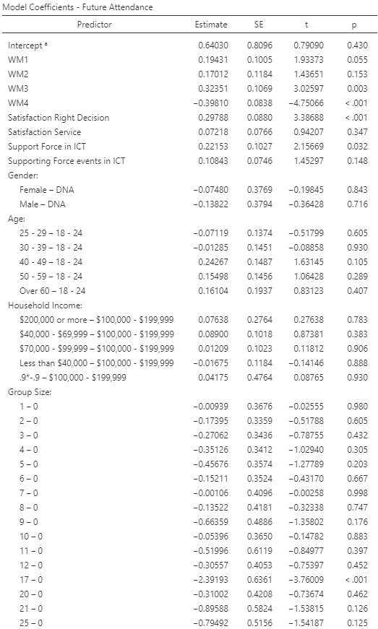
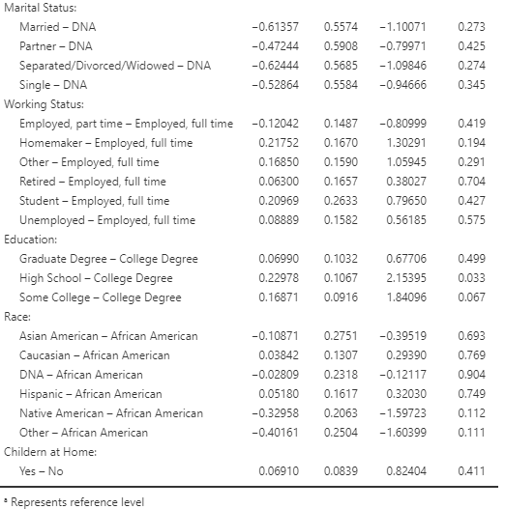

Backup Slides - OLM
Good predictive power (81%)
Acceptable error for data count (38%)
OLM Factors
Marital status
Working status
Education
Race
Children
Gender
WM
Age
Income
Group Size
Bottom Line: Based on the 2024 (2019) survey, we have good predictors of what makes fans: good service, value, and winning!

